Slide 1
SUSI
Student Universal Support Ireland
Ms. E. Daly/Ms. Mc Donald
Ms Mulligan/ Ms S. Daly
Guidance Counsellors

Slide 3
Key Eligibility Criteria
Approved Courses/Colleges
Nationality (Must be Irish, EU, EEA, a Swiss national, or have specific leave to remain in the
state)
Residency (3 of the last 5 years in Ireland, the EU, the EEA or Switzerland)
Income (All household income -applicant and others
The 2023(Jan to Dec) Gross Income must be under the income
threshold levels)
Progression through Education

Slide 4
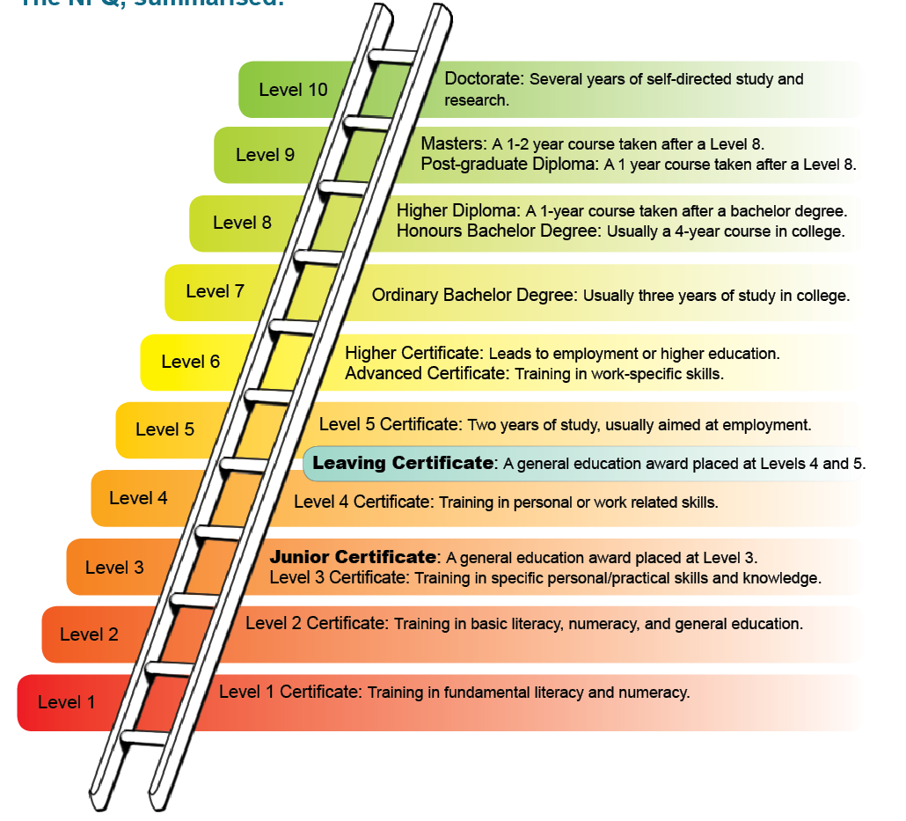

Slide 5
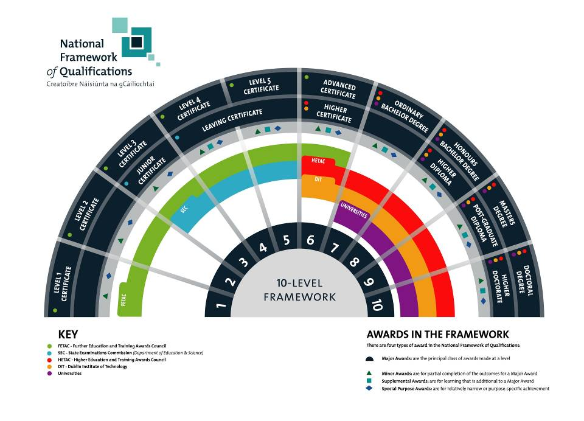

Slide 6
How is Income Assessed?
Leaving Certificate students are generally ‘dependent’ students (unless over 23)
Students will be assessed on their own income and that of their parents/guardians

Slide 7
How to Apply?
ONLINE at www.susi.ie (March/April 2024)
Create your Account in your SUSI Student Portal
NEED
CAO or UCAS number (if you have one)
PPSN numbers for yourself, your parent(s) or legal guardian(s), spouse/cohabitant or civil partner, as appropriate
Income details for 2023 for yourself (if any) your parent(s) or legal guardian(s), spouse/cohabitant or civil partner, as appropriate.

Slide 8
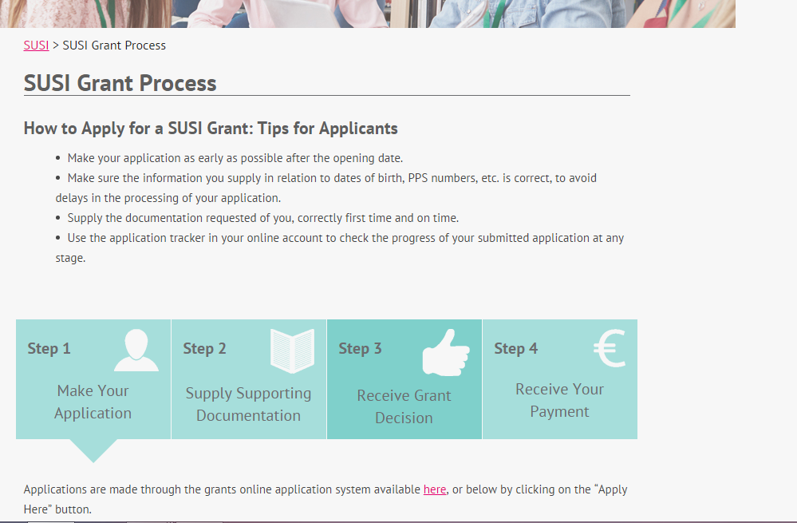

Slide 9
Step 1..Making Application
Section A: Personal Details (applicant)
Section B: Nationality & Residency (applicant)
Section C: Course Details, Previous Education & other sources of Student Financial Support
Section D: Personal details (parents, legal guardians, spouse, civil partner or cohabitant)
Section E: Dependent children & Relevant Persons
Section F: Income (applicant, parents, legal guardians, spouse, civil partner or cohabitant)

Slide 10
Step 2..Supplying Documentation
Submit application
SUSI will contact you within 4-6 weeks
If deemed ineligible - you will receive a refusal letter
If eligible - receive a letter - documentation
Once documents sent - your application will be reviewed - further 4-6 weeks

Slide 11
Step 3.. Receive Grant Decision
Awarded
An award letter is issued to you offering you a grant and highlighting the further steps you need to take before your grant can be paid.
Refused
A refusal letter is issued to you. This letter will also highlight the further steps you may take if you wish to review or appeal your grant decision.

Slide 12
Step 4..Receive your Payment
Earliest grant payments are made in mid-October
Registration & attendance needs to be confirmed by your college
SUSI pays maintenance grants in 9 monthly installments

Slide 13
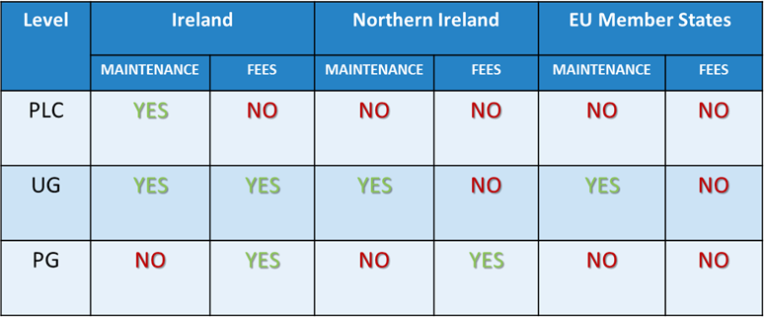
Types of Study

Slide 14
So what does getting a grant mean?
Maintenance grant
contribution towards the costs of college
9 monthly installments
25%, 50%, 75%,100% rates
Adjacent rate: reside within 30km of college (€1,613)
Non-adjacent rate: reside over 30km from college (€3,677)
Special rate: €2,936 adjacent/ €6,971 non-adjacent. Income <€25,000
Fee grant
€3,000 Student Contribution
50% or 100% rates
Paid directly to College
NOTE:
Most PLC/CAO students in the state do not pay any tuition fees as the government Free Fees Initiative is still in place
The student contribution fee (subject to change) was €3,000 up to and incl. 2021 & was €2,000 in 2022

Slide 15
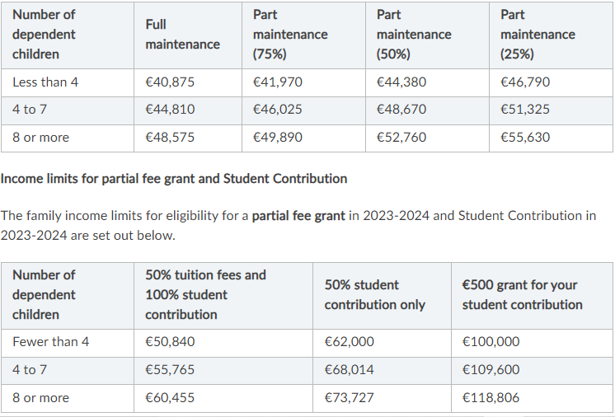

Slide 16
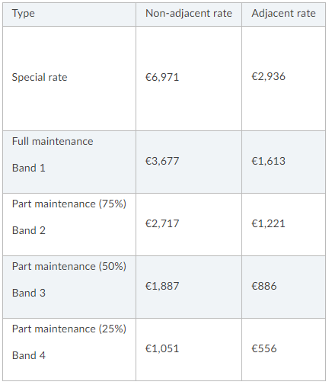

Slide 17
Budget Changes for 2024 1. An increase to the income threshold for Band 4 Maintenance from €46,790 to €50,840. 2. An increase to the income threshold for 100% Student Contribution grant from €50,840 to €55,924. 3. From September 2024, the Student Contribution fee is abolished for all incomes under €55,924.

Slide 18
Budget Measures Effective September 2024 The non-adjacent maintenance rates will increase by €615 and the adjacent maintenance rates will increase by 10%.

Slide 19
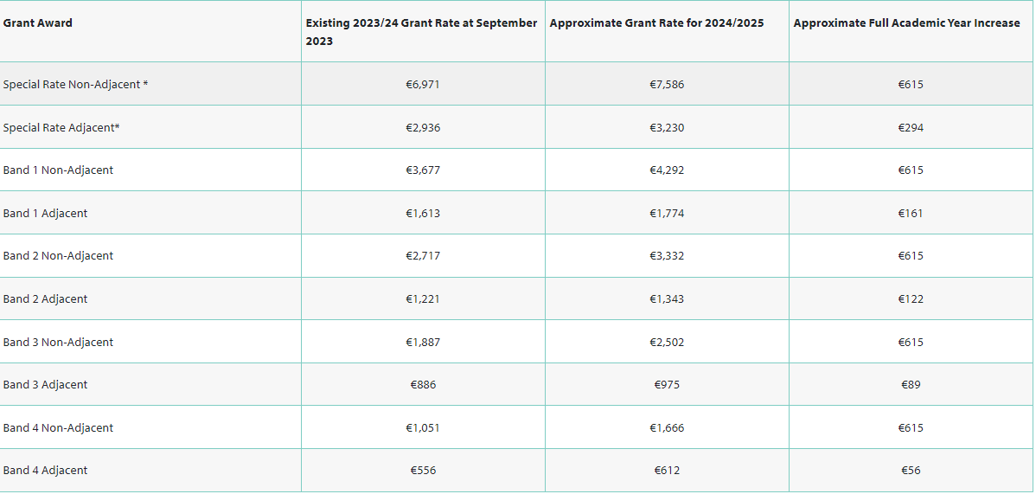

Slide 20
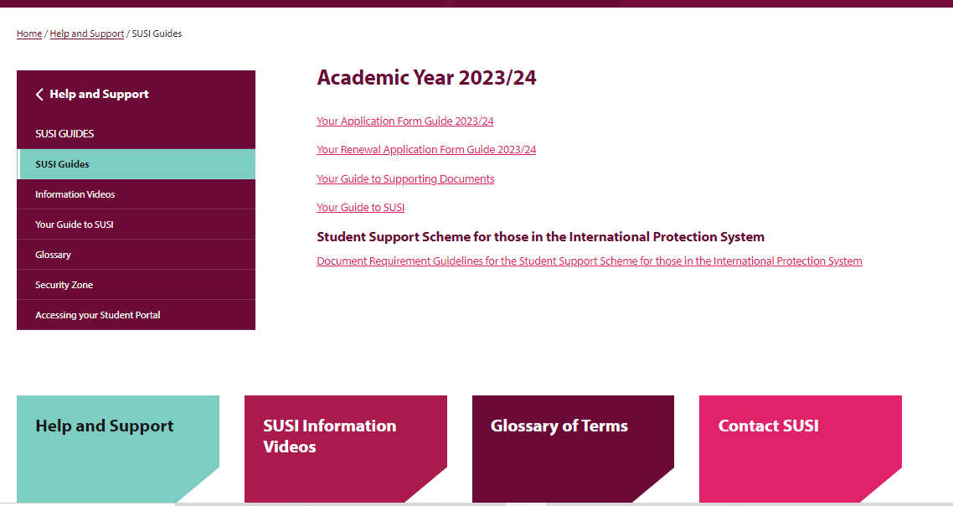

Slide 21
Useful websites
www.susi.ie
www.studentfinance.ie
www.citizensinformation.ie
www.careersportal.ie

Slide 22
Access Scheme: DARE
DARE - Disability Access Route to Education
21 DARE and 21 HEAR Colleges
Quota of places offered on a reduced points basis
Minimum entry requirements
See www.accesscollege.ie for list of disabilities eligible
Advice Clinics January 2024 Nationwide
Notes:
Students applying via these routes are required to complete their CAO Application on-line as additional forms necessary to complete their application are on-line only.
Disclose any disability in full, as it will not adversely affect your application or your legal rights.
Further information available on:
www.cao.ie
www.collegeaccess.ie
Websites of participating HEIs
Page 8/9 of Handbook

Slide 23
Access Scheme: HEAR
HEAR - Higher Education Access Route
Students from socio-economically disadvantaged backgrounds
Quota of places offered on a reduced points basis
Meet minimum entry requirements
Must satisfy 3 of the 6 indicators
See www.accesscollege.ie for further information
Advice Clinics January 2024 Nationwide
Notes:
Higher Education Access Route- HEAR 3rd level admissions scheme for school leavers from
Socio-Economically disadvantaged backgrounds.
Students who wish to be considered must fill in appropriate section in Part A of Application Form.
Additional questions relating to family income, employment status of parents and school(s) attended will be asked.
Applications for HEAR can only be made online.
February 1, 2010: Complete all elements of online HEAR application as part of the CAO application process.
April 1, 2010:Submit relevant evidence of family financial circumstances to CAO.
See page 8 of CAO Handbook

Slide 24
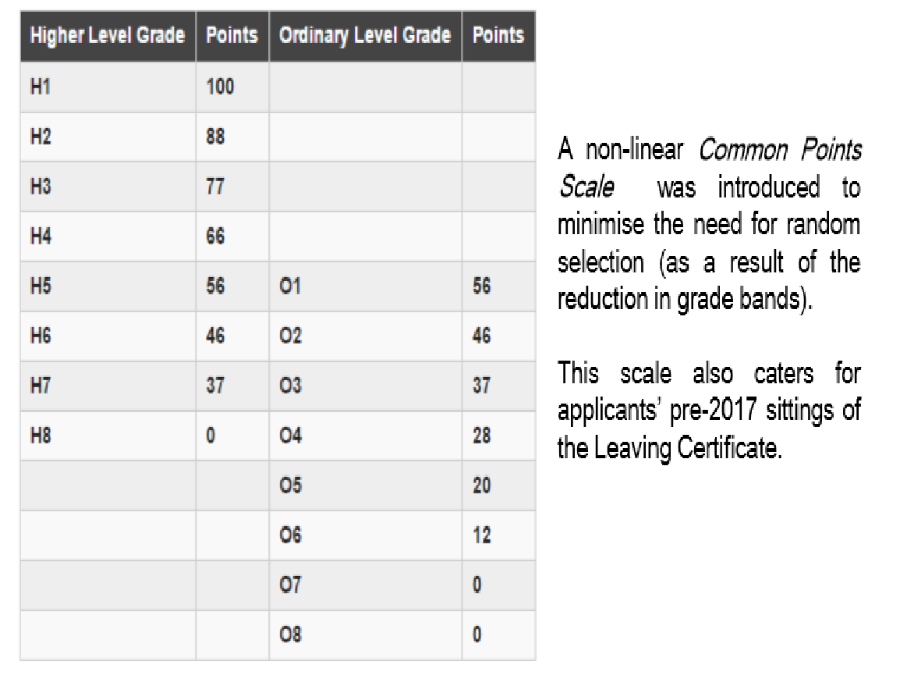

Slide 25
www.classroomguidance.ie
Video Guides

Slide 26
Post Leaving Cert Courses
Who is PLC for?
Students not ready / unsure about university.
Students who want access to university via the “Higher Education Links Scheme”.
Discovering a vocational area.
Leaving Cert Applied students.

Slide 27
PLC courses:
Offer a great variety of courses in your locality, designed for the industry you want to get into. They are an alternative route into university or college.

Slide 28
What Is An Apprentice?
An apprentice is a person who works for an employer in a chosen occupation and gains the necessary skills, knowledge and attitudes to become a qualified craftsperson.

Slide 29
In Ireland We Have Two Types of Apprenticeships
25 “Craft” Traditional Apprenticeships
37 “New” Apprenticeships

Slide 30
Craft Apprenticeships - Learning happens in phases

Slide 31
New Apprenticeships Have a Varied Education Structure
Can be a mix of:
Go to College once a week
Online learning in the evenings
Go to College twice a week
Varied block release for different modules

Slide 32
New Type of Apprenticeship Warning!!
Only around 10% of the new type of Apprenticeships go to school leavers!

