Slide 1
Maynooth University
CAO 2024
Kay Mitchell School’s Liaison officer

Slide 2
CAO Entry 2024
Third Level Education
Considerations
Application Process

Slide 3
Graduate Profile
Employment :
Personal Responsibility= deadlines
Research/ verification of source material
Work on your own initiative/ collaborate
Critical analytical skills…….
What you have to offer to this area of work?

Slide 4
Responsible for your own education...
Self-directed learning
Study the subjects you choose/want to study
Study however you work best
Work/life balance - manage your own time
Flexible degree pathways
Costs involved
Differences Between School and
University

Slide 5
Student contribution Fees €3,000 until recently
Post Budget:
The Student Contribution will be reduced by €1,000 in the 2023/2024 academic year for students who qualify for the Free Fees Scheme.
From September 2024, the Student Contribution fee will be abolished for all incomes under €55,924.
Ref: Citizens Information post Budget Announcement
Student Contribution
Fees
Withdrawal from University- fee implications

Slide 6
College publications & websites
Guidance Counsellors/teachers
Current students/ graduates/ people
doing the job that interests the applicant
Studentfinance.ie
for information on grants
Accesscollege.ie
for information on HEAR and DARE criteria
Open Days
Sources of
Information

Slide 7
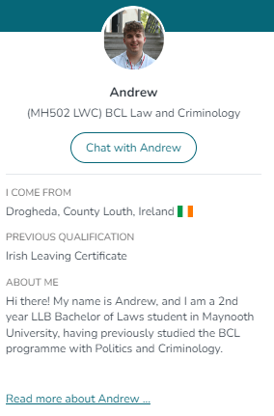
Ask a Student Platform
Chat to current students from Maynooth University
It’s great for:
Prospective students who get information, reassurance and a greater shot at success in choosing the right path for them, through peer-to-peer engagement on the MU Ask a Student Platform
Find us on:
maynoothuniversity.ie/ask-a-student

Slide 8
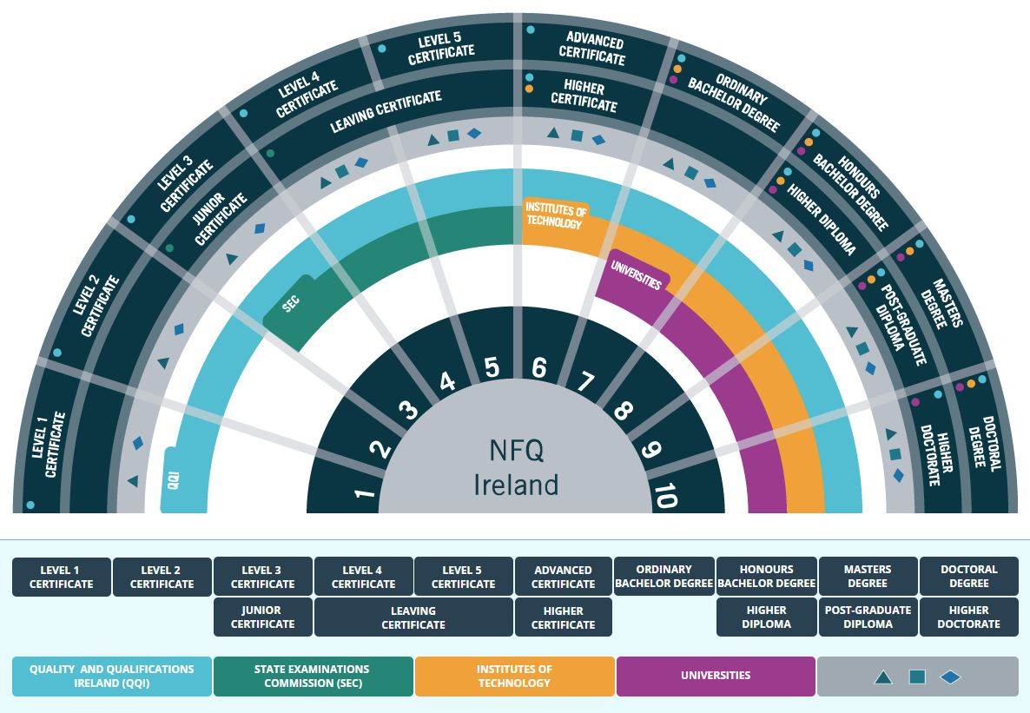
Pathways to qualifications

Slide 9
Third Level
Education
In Ireland
2nd Level
Course Duration
QQI/FETAC
Level 5: 1 Year
Level 6: 2 & 3 Years
Level 6: Higher Certificate
Level 7: Ordinary Degree
Level 8: Honours Degree
Technological Universities
Universities
Level 8: 3 & 4 Yr
Honours Degrees

Slide 10
CAO Handbook 2024
Important….
6th November
20th January
1st February
7th May
1st July
CAO Opens
Discounted
Application
Fee (€30) prior to Jan 20th
After Jan 20th- (€45)
CAO Closes
Restricted Courses**
Change of
Mind opens
Change of
Mind closes
Deadlines are not flexible
Applicants must satisfy:
Matriculation Requirements
Course Requirements
Points
Other Options: there will be a prominent link from CAO.ie to fetchcourses.ie and apprenticeship.ie

Slide 11
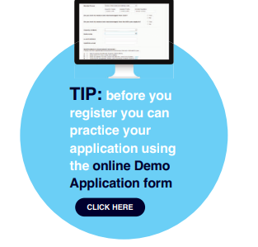
Applying to the CAO

Slide 12
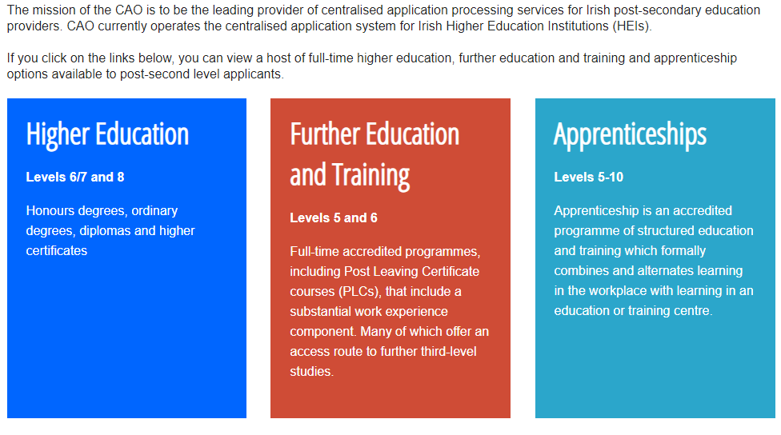
Applying to the CAO

Slide 13
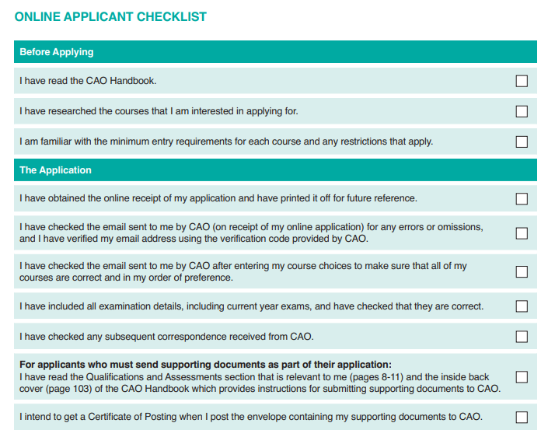
Check List

Slide 14
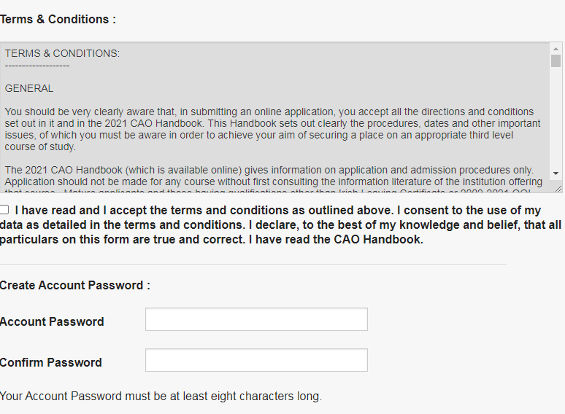
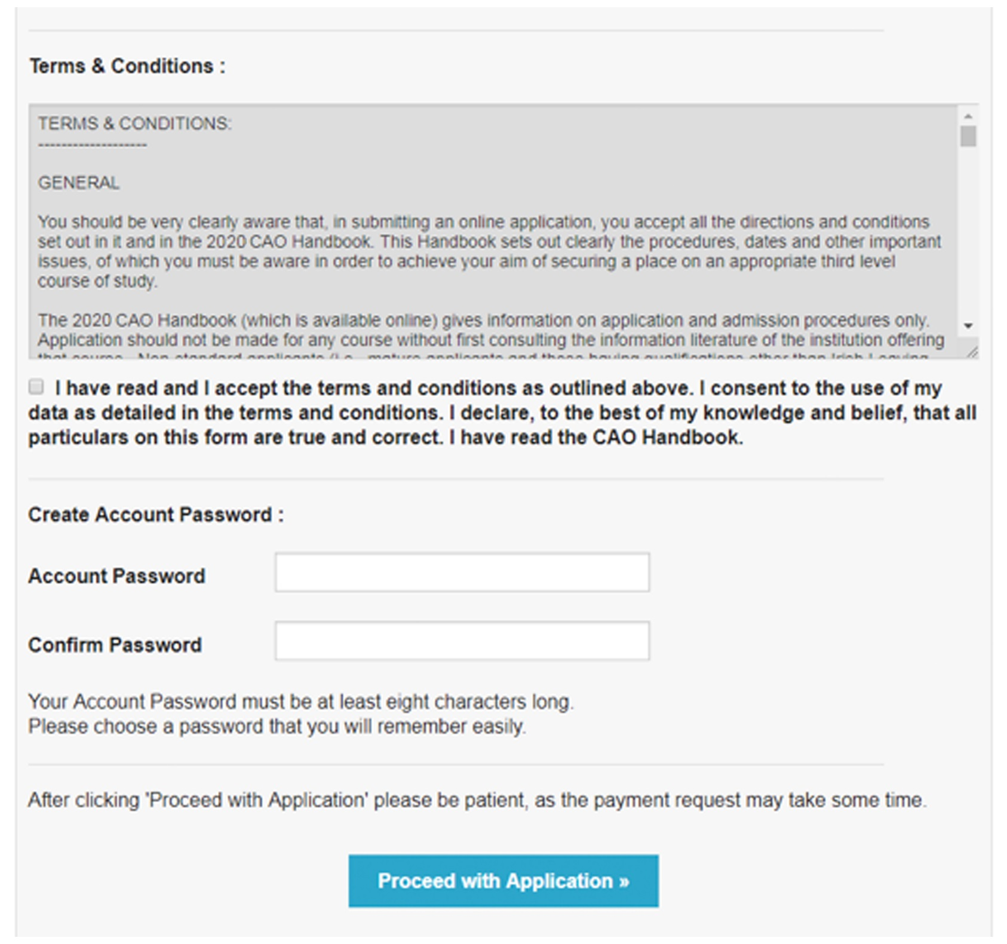
Applying to the CAO

Slide 15
The application number will be communicated by email, also texted to the applicant if applicant has ticked permission for this.
This number is private and it will be used in every correspondence between applicant and the CAO for the rest of the year.
Applicant must create password for their own CAO account
CAO Application Number

Slide 16
Further Information: www.accesscollege.ie

Slide 17
DARE (Disability Access Route to Education)
A third level admissions scheme for school leavers whose disabilities have had a negative impact on their second level education
HEAR (Higher Education Access Route)
A third level admissions scheme for school leavers from long-term socioeconomically disadvantaged backgrounds
HEAR / DARE Information Sessions
January 13th 2024
Notes:
HEAR

Slide 18
**Aims to give applicant their highest choice**
Check the statement of information the CAO sends in May
Level 8
1.
2.
3.
4.
5.
6.
7.
8.
9.
10.
Level 7 / 6
1.
2.
3.
4.
5.
6.
7.
8.
9.
10.
CAO System: How it Works
July 1st – 5pm deadline

Slide 19
CAO Offers Schedules
Subsequent Rounds - you can accept or ignore
Available Places
Upgrades
Deferral
Random Selection
Accepting a place on CAO- you can change your mind

Slide 20
admissions@mu.ie
01 708 3822
Maynoothuniversity.ie
on
webchat
@MaynoothUni
@MaynoothCAO

